Slide 1
Azure Face API with Real-Time Message Broker(RTMB) Service and Plotly JS
Tadesse, Wonde

Slide 2
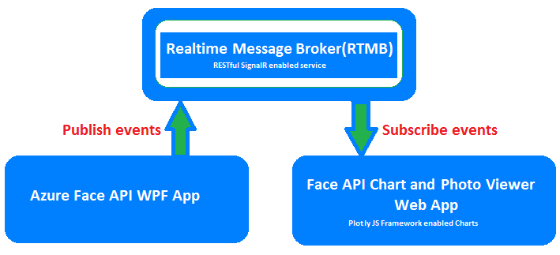
Topics
Explanation of Azure Cognitive Services and Artificial Intelligence.
Explanation about Azure Face API.
Benefits of using Azure Face API in real world application.
Limitation of Azure Face API.
How to create Azure Face API service on the cloud.
How to consume Azure Face API service in .NET framework, WPF and Web apps.
How to present Azure Face API face attribute results on Web application.
How to use Realtime Message Broker(RTMB) pattern.

Slide 3
Continuation
How to use Message Broker pattern.
How to use pub/sub pattern on Azure Face API face attribute results.
How to use RESTful service on pub/sub pattern.
How to use SignalR library for real time data result transmission.
How to use Plotly JS framework for data visualization, Charting.
How to present Face API identified photo in Web app.
Demo and resource links.

